Slide 1

Movie Revenue Prediction
Shariq Hashmi

Slide 2
Business Problem
Movie Revenue Prediction
Business Need: A movie studio while budgeting a movie production wanted a deeper insight and a clearer budgeting amount for allocating investment funds in producing a movie. The client wanted a data-driven decision based on the historical data, they wanted a prediction model which can predict a movie’s revenue collection once its released. This prediction model will help the movie sponsors to allocate budget amount with much better confidence.
A historical dataset was provided comprised mainly of categorical variables. Since machine learning models take only numerical inputs, the dataset needed to be modified and reformatted before being fed to the model.

Slide 3
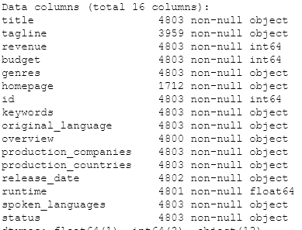
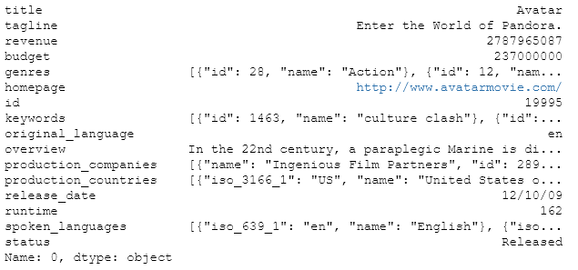
Data Understanding
Data has 4803 Rows and 16 Columns
  4 columnas numeric and 12 non numerus

Slide 4
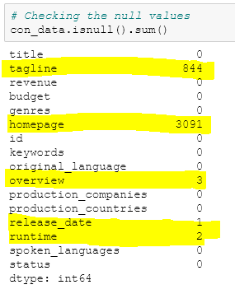
Data Understanding
Missing values:
  Tagline → 844
  Homepage → 3091
  Overview → 3
  Released date → 1
  Runtime → 2

Slide 5
Data Preparation
Selected few variables (genres, revenue, budget, runtime, status)
Removed observations with missing values
Convert String to List
Convert Date (Split into Month/Day/Year)
Fix Date with 2 Digits
Pulled values of the dictionaries (using the “NAME” value)
For genres column, I picked the first element of the NAME list

Slide 6
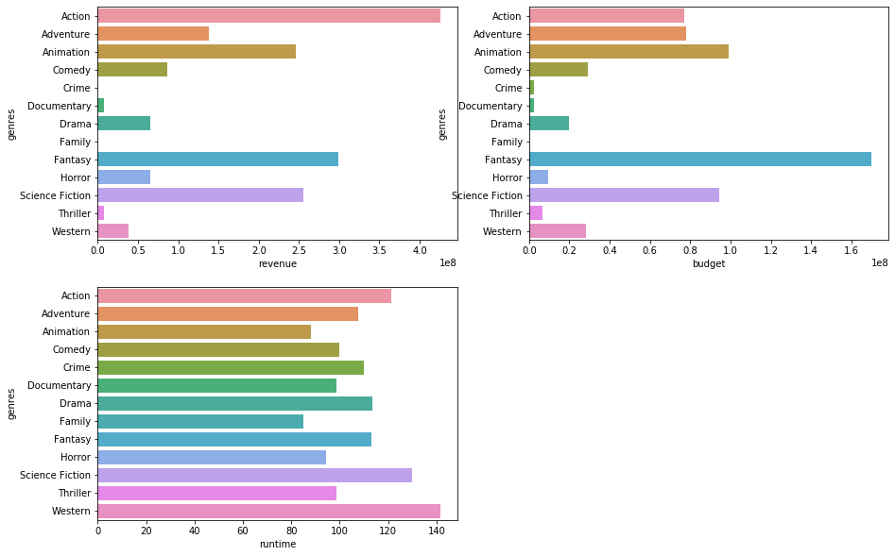
Data Viz
Distribution of revenue per genres
Distribution of Budget per genres
Distribution of runtime per genres

Slide 7
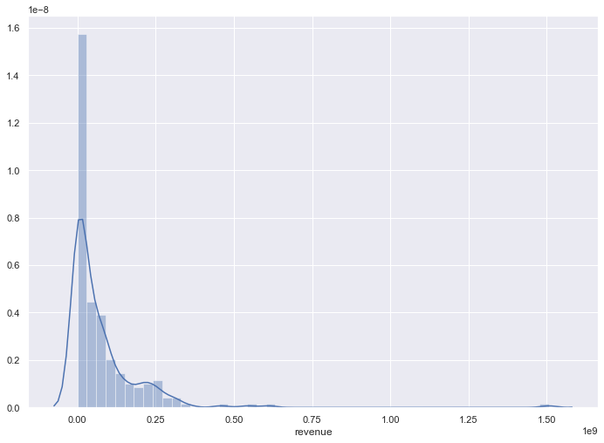
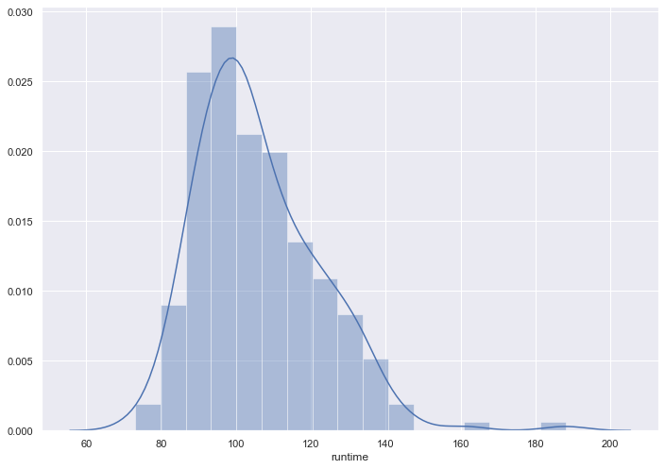
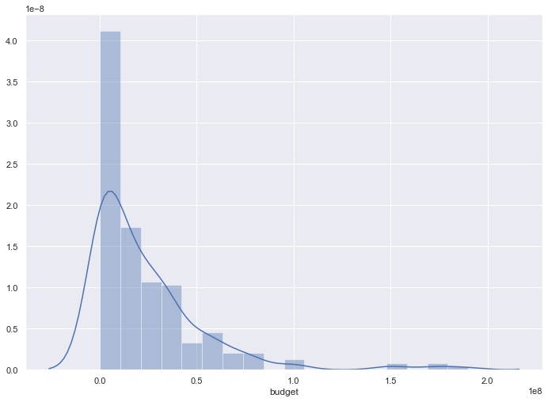
Data Viz
Distribution of revenue
Distribution of Budget
Distribution of runtime

Slide 8
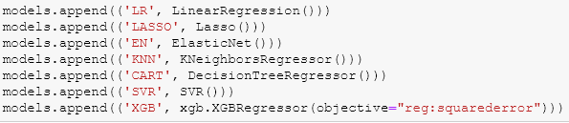
Analytical Approach
    Used Linear Regress
    Used Lasso Regression
    Used ElasticNet
    Used KNN
    Used CART
    Used Support Vector Machine for Regression
    Used XGboot

Slide 9
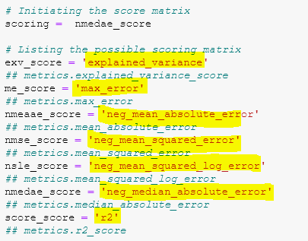
Algorithm - Testing
metric calculates the maximum residual error.
Mean absolute error regression loss
Mean squared error regression loss
Mean squared logarithmic error regression loss
Median absolute error regression loss
R^2 (coefficient of determination) regression score function.

Slide 10
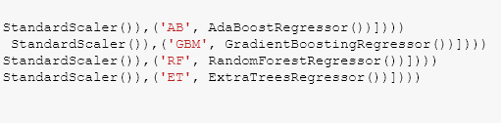
Analytical Approach(Ens.)
    AdaBoost Regressor
    Gradient Boosting Regressor
    Random Forest Regressor
    Extra Trees Regressor

Slide 11
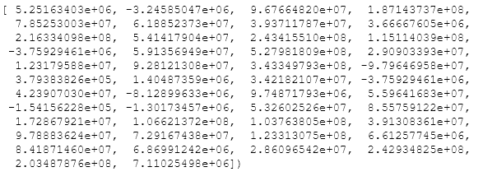
Analytical Approach(LR)
    Linear Regression

Slide 12
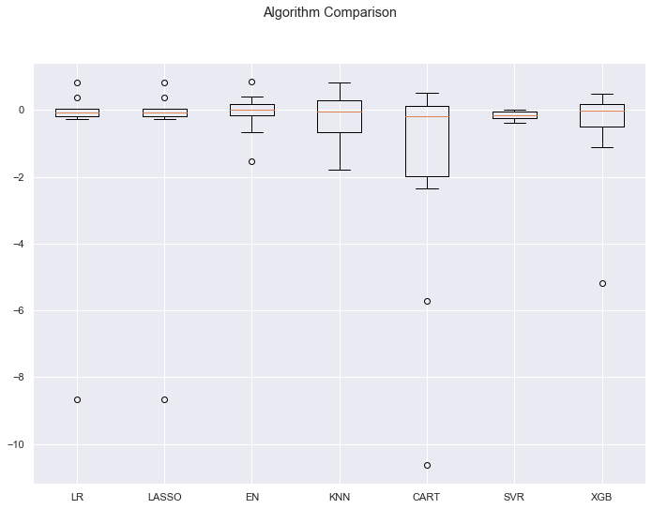
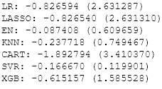
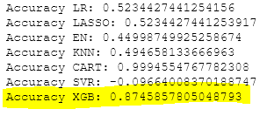
Algorithm - Validation
Models comparison with Data as-is
Models comparison(mean & std of R2 values)
Models comparison(Accuracies)

Slide 13
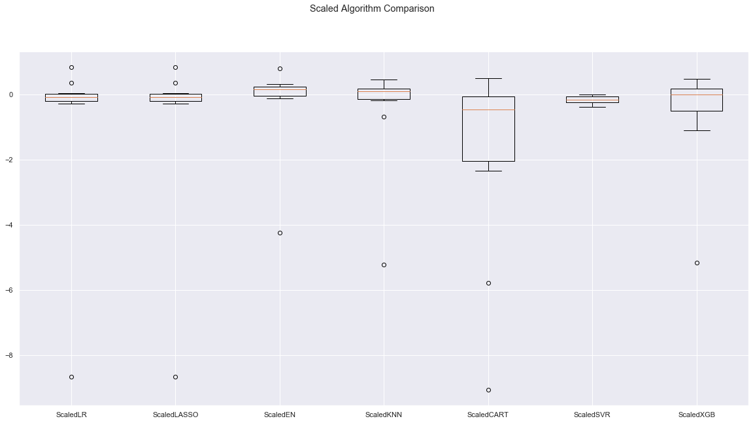
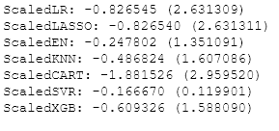
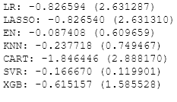
Algorithm - Validation
Models comparison with Data scaled
Models comparison with Data as is

Slide 14
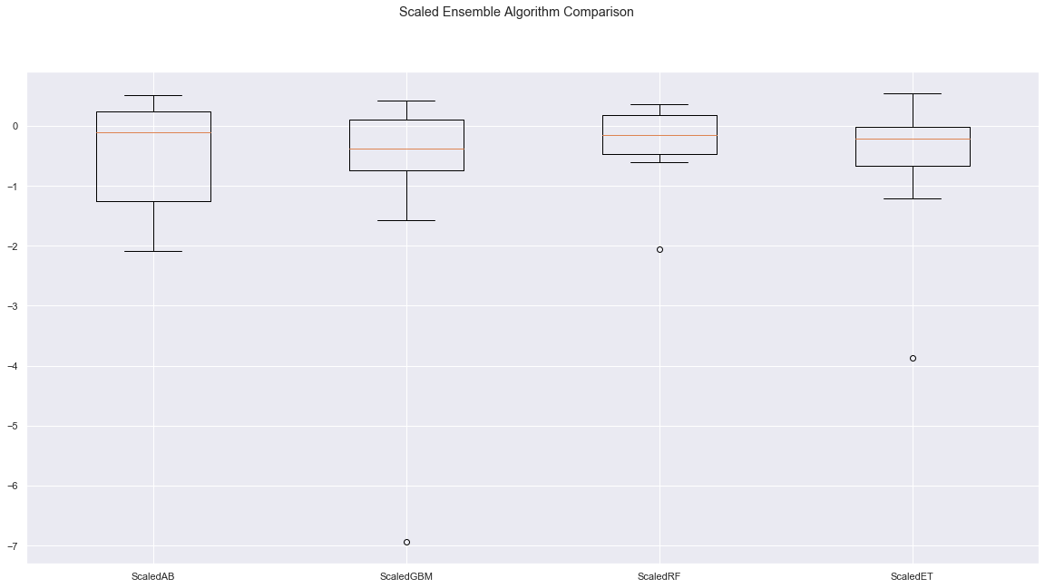


Algorithm - Validation
Ensemble Methods comparison with Data scaled
Ensemble Methods Accuracy comparison with Data scaled

Slide 15
Recommendation
    I used only few variables (genres, revenue, budget, runtime, status) and for the genres, I used the first name. I could have used all names and transform them in Dummy variables….
    Other variables requires in depth machine learning to extract features: example I could have used NLP for the overview/tagline/Keywords columns, to transform meaningful works into matrix(TF-IDF)

